Slide 1
Primjena lijeka ocrelizumab u tretmanu RMS i PPMS
Doc. Dr. Sanja Grgić
Trebinje, 2019.

Slide 2
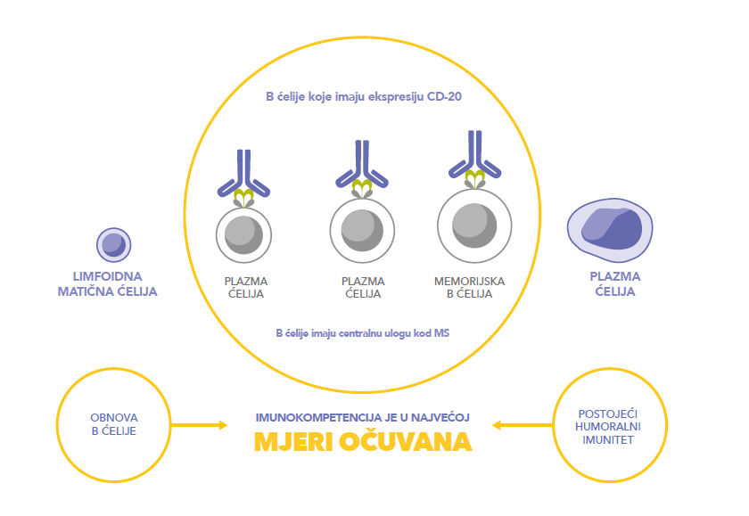
Lijek OCREVUS® (Ocrelizumab) je rekombinantno humanizirano monoklonalno antitijelo¹ koje selektivno cilja i vrši depleciju B ćelija koje imaju CD-20 ekspresiju
1. Sažetak glavnih svojstava lijeka za OCREVUS® (okrelizumab)

Slide 3
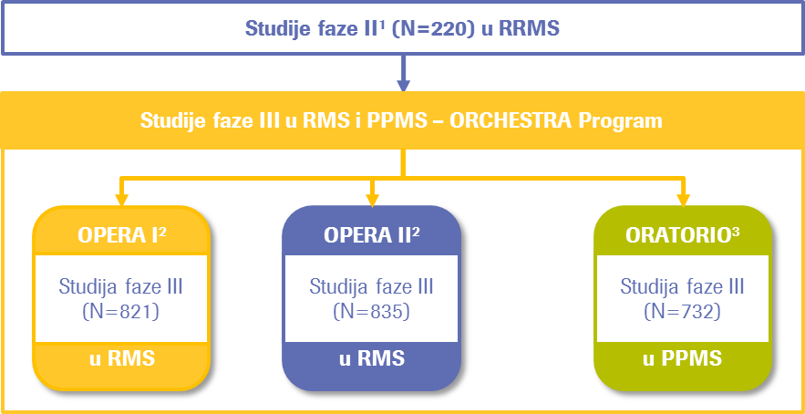
Klinički razvoj lijeka OCREVUS® (Ocrelizumab)
Ocrelizumab je ispitivan u jednom ispitivanju Faze II i tri ispitivanja Faze III unutar ORCHESTRA programa
¹Kappos L, et al. Lancet 2011;378:1779–1787; ²Hauser SL, et al. N Engl J Med 2017;376:221–234;³Montalban X, et al. N Engl J Med 2017;376:209–220.

Slide 4
OPERA I i OPERA II: Dizajn studije
BL, baseline; CDP, confirmed disability progression; IFN, interferon; OLE, open-label extension; SC, subcutaneous
Hauser SL, et al. Presented at ECTRIMS 2018 (Poster number P590).
Notes:
*Patients in the ocrelizumab group received placebo injections three times weekly, while patients in the IFN β-1a group received placebo infusions at Days 1 and 15 and Weeks 24, 48 and 72; †OLE was not mandatory. Patients who declined to participate in the OLE entered safety follow-up; ‡Continued monitoring occurs if B cells are not repleted.

Slide 5
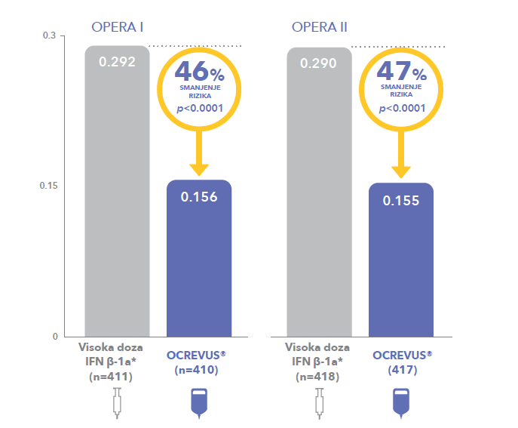
Lijek OCREVUS® (Ocrelizumab) signifikantno reducira ARR u poređenju sa IFN β-1a
ARR – Anual Relaps Rate, godišnja stopa relapsa
Hauser SL, et al. N Engl J Med 2017;376:221–234. Supp. Appendix.

Slide 6
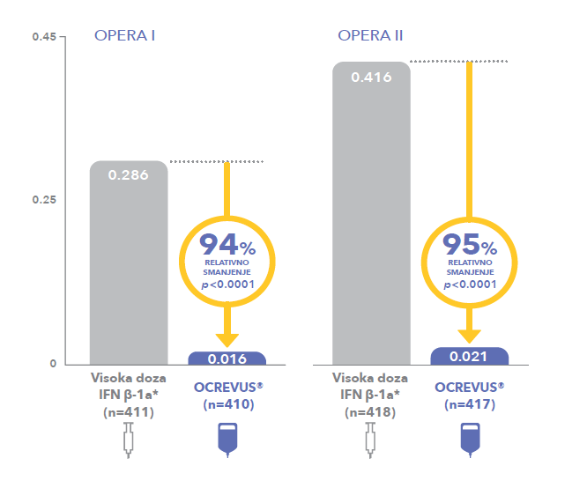
Lijek OCREVUS® (Ocrelizumab) signifikantno reducira broj uvećanih T1 Gd + lezija u poređenju sa IFN β-1a
Hauser SL, et al. N Engl J Med 2017;376:221–234. Supp. Appendix.

Slide 7
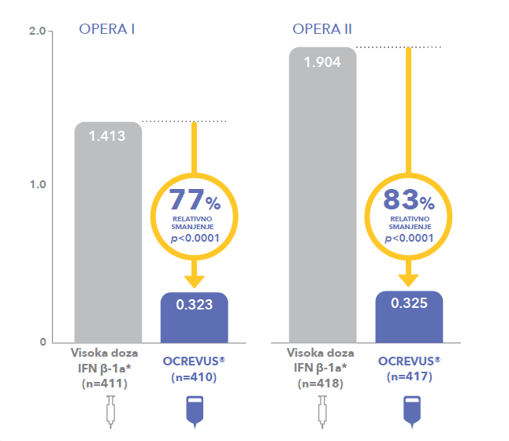
Lijek OCREVUS® (Ocrelizumab) signifikantno reducira broj novih ili uvećanih T2 hiperintenzivnih lezija u poređenju sa IFN β-1a
Hauser SL, et al. N Engl J Med 2017;376:221–234. Supp. Appendix.

Slide 8
OPERA I i OPERA II Post hoc analiza: Rizik dostizanja EDSS 4.0 Pacijenti sa polaznom osnovom EDSS ≤3.0
10
IFN β-1a (n=544)
10
IFN β-1a (n=544)
Ocrelizumab 600mg (n=538)
Ocrelizumab 600mg (n=538)
8
HR (95% CI): 0.40 (0.23, 0.69); p<0.001
8
HR (95% CI): 0.39 (0.20, 0.73);
p=0.004
Smanjenje rizika za 60%
6
6
Kumulativna vjerovatnoća (%)
Smanjenje rizika za 61%
Kumulativna vjerovatnoća (%)
4
4
2
2
0
0
0
12
24
36
48
60
72
84
96
0
12
24
36
48
60
72
84
96
Vrijeme do 12-sedmičnog potvrđenog EDSS 4.0 (sedmice)
Vrijeme do 24-sedmičnog potvrđenog EDSS 4.0 (sedmice)
EDSS, Expanded Disability Status Scale; HR, hazard ratio; IFN β-1a, interferon beta-1a; ITT, intention-to-treat.
Kappos L, et al. Presented at EAN 2017 (Presentation PR2079).
Notes:
Hazard ratio derived from a Cox model stratified by region (USA, rest of world) with baseline EDSS and treatment group included as covariates.

Slide 9
OPERA I i OPERA II Post hoc analiza: Rizik dostizanja EDSS 6.0 ITT populacija
10
IFN β-1a (n=829)
10
IFN β-1a (n=829)
Ocrelizumab 600mg (n=827)
Ocrelizumab 600mg (n=827)
8
HR (95% CI): 0.40 (0.23, 0.72); p=0.002
8
HR (95% CI): 0.41 (0.22, 0.76); p=0.005
6
6
Smanjenje rizika za 60%
Smanjenje rizika za 59%
Kumulativna vjerovatnoća (%)
Kumulativna vjerovatnoća (%)
4
4
2
2
0
0
0
12
24
36
48
60
72
84
96
0
12
24
36
48
60
72
84
96
Vrijeme do 12-sedmičnog potvrđenog 6.0 (sedmice)
Vrijeme do 24-sedmičnog potvrđenog EDSS 6.0 (sedmice)
EDSS, Expanded Disability Status Scale; HR, hazard ratio; IFN β-1a, interferon beta-1a; ITT, intention-to-treat.
Kappos L, et al. Presented at EAN 2017 (Presentation PR2079).
Notes:
Hazard ratio derived from a Cox model stratified by region (USA, rest of world) with baseline EDSS and treatment group included as covariates.

Slide 10
Time to onset of CDP for at least 48 weeks during the DBP and OLE periods
IFN β-1a/OCR 600 mg (N=829)
57% risk reduction
30
OCR 600 mg/OCR 600 mg (N=827)
25
20
Proportion of patients having CDP-EDSS
Start of OLE: all patients treated with OCR
15
DBP: HR=0.43; (p<0.001)
10
5
∆=4.40 (1.92, 6.88); p<0.001
∆=5.20 (2.19, 8.21) p<0.001
∆=4.71 (1.29, 8.14) p=0.007
∆=5.37 (1.76, 8.97) p=0.004
0
BL
24
48
Year 1
72
96 Year 2
OLE Baseline
120
144 Year 3
(OLE Year 1)
168
192 Year 4
(OLE Year 2)
216
240 Year 5
(OLE Year 3)
264
Time to onset of CDP (weeks)
No. of patients at risk
829
789
753
715
690
657
639
618
606
552
540
527
525
512
507
491
490
474
471
459
457
319
297
IFN β-1a/OCR 600 mg
OCR 600 mg/OCR 600 mg
827
795
778
762
751
735
724
712
699
665
650
633
629
600
599
586
585
575
573
560
559
397
380
Without imputation. ITT population. Pooled OPERA I and OPERA II population; DBP clinical cut-off dates: April 2, 2015 and May 2, 2015, respectively; OLE clinical cut-off date: February 5, 2018. Data shown up to Week 240, the last visit all ongoing patients completed. CDP, confirmed disability progression; BL, baseline; DBP, double-blind periods; EDSS, Expanded Disability Status Scale; HR, hazard ratio; IFN, interferon; ITT, intention-to-treat; OCR, ocrelizumab; OLE, open-label extension.
Hauser SL, et al. Presented at AAN 2019 (Poster number P3.2-054).
Notes:
The benefits of ocrelizumab on 48-week CDPª observed in the 2-year DBP were greater than for 12- and 24-week CDP, potentially due to a higher specificity for permanent disability accumulation
Overall, 88.6% of patients who entered the OLE phase of the OPERA studies completed Year 3 of the OLE
The benefit was maintained after 3 years’ ocrelizumab treatment in the OLE
After 5 years of follow-up, the 48-week CDP benefits accrued in those initiating ocrelizumab 2 years earlier were maintained versus those switching from IFN β-1a to ocrelizumab at OLE baseline
These results support previous analyses of the sustained effect of ocrelizumab on the reduction of risk of disability progression in patients with RMS

Slide 11
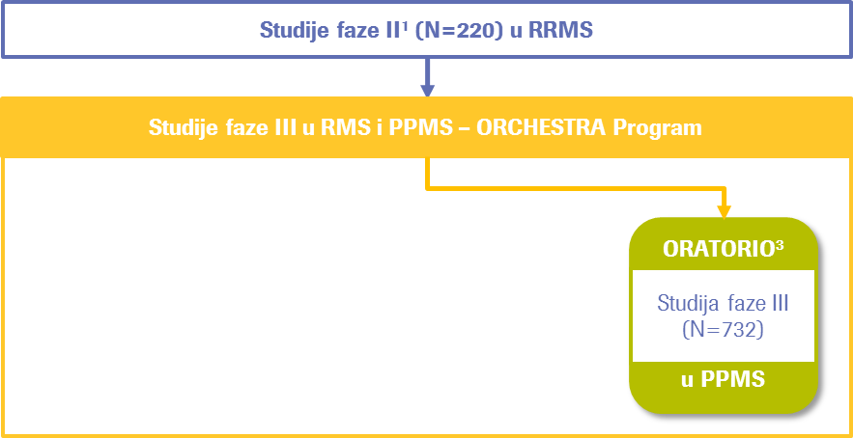
Klinički razvoj lijeka OCREVUS® (Ocrelizumab)
Ocrelizumab je ispitivan u jednom ispitivanju Faze II i tri ispitivanja Faze III unutar ORCHESTRA programa
³Montalban X, et al. N Engl J Med 2017;376:209–220.

Slide 12
OCREVUS ®
U.S. FDA dodjeljuje Breakthrough Therapy Designation za Roche lijek ocrelizumab u primarno progresivnoj formi MS. Ocrelizumab je prvi
ispitivani lijek koji je dobio status Breakthrough Therapy Designation u
Multiploj sklerozi (MS)¹.
Dvanaesti Breakthrough Therapy Designation u Roche portfoliu od 2013².
¹https://www.fda.gov/newsevents/newsroom/pressannouncements/ucm549325.htm, pristupljeno 19.10.2018. ²https://www.roche.com/investors/updates/inv-update-2016-02-17.htm pristupljeno 19.10.2018.
Notes:
Breakthrough Therapy Designation dizajniran je da ubrza razvoj lijekova namijenjenih za liječenje ozbiljnih ili životno opasnih bolesti i da pomogne da se ljudima omogući pristup odobrenjem FDA što je prije moguće. Oznaka je zasnovana na pozitivnim rezultatima iz kliničke studije faze III (ORATORIO), koja je pokazala da tretman sa ocrelizumabom značajno smanjuje progresiju invaliditeta i druge markere aktivnosti bolesti u poređenju sa placebom. Vrhunski rezultati su predstavljeni na 31. Kongresu Evropskog komiteta za liječenje i istraživanje u multipleksnoj sklerozi (ECTRIMS) u oktobru 2015. godine.

Slide 13
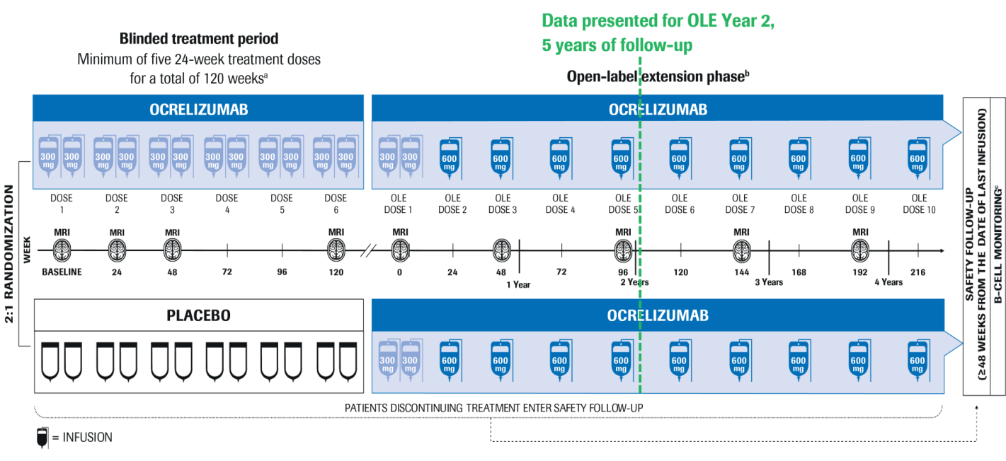
ORATORIO: Dizajn studije
³Montalban X, et al. N Engl J Med 2017;376:209–220.

Slide 14
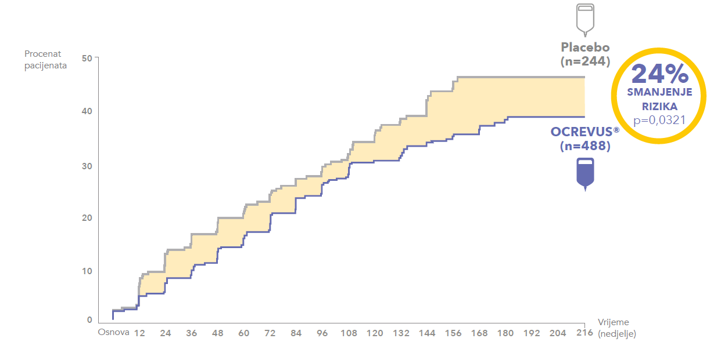
ORATORIO Primarni ishod: Vrijeme do pojave 12-sedmične potvrđene progresije onesposobljenja (12-week CDP)
Wolinsky JS, et al. Presented at ECTRIMS 2017 (Poster 1234).

Slide 15
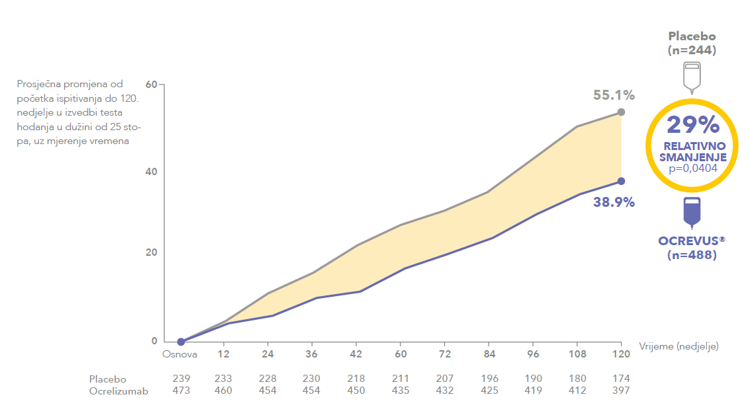
ORATORIO Sekundarni ishod: mjerenje pogoršanja na osnovu testa hodanja u dužini od 25 stopa (T25FW)
Wolinsky JS, et al. Presented at ECTRIMS 2017 (Poster 1234).

Slide 16
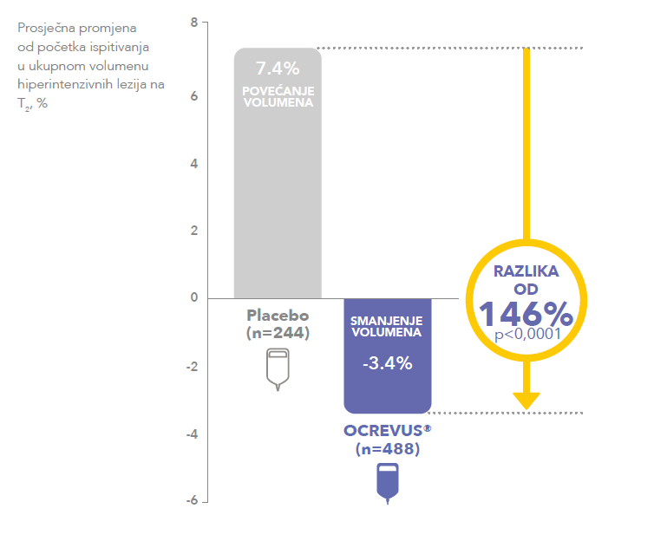
ORATORIO Sekundarni ishod: Ukupan volumen hiperintenzivnih T2 lezija
Wolinsky JS, et al. Presented at ECTRIMS 2017 (Poster 1234).

Slide 17
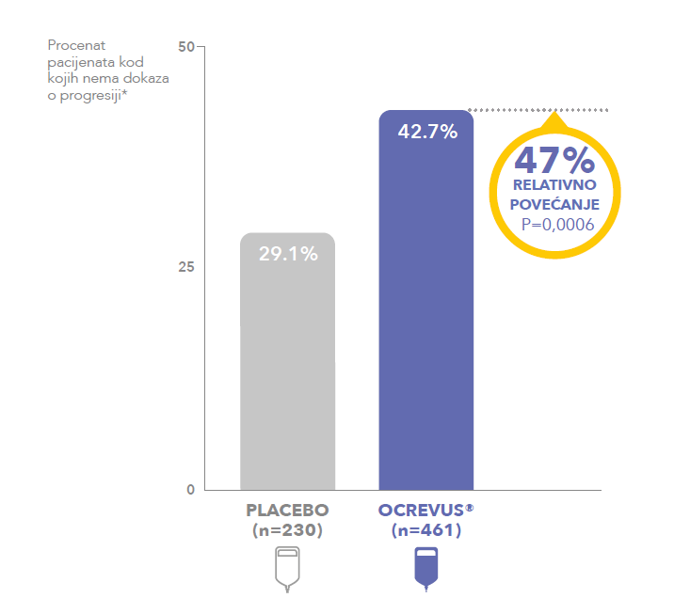
ORATORIO Ekspaloratorni ishodi: Značajno veći broj pacijenata koji su primali Ocrelizumab nije imao dokaze o progresiji u poređenju sa placebom
Wolinsky JS, et al. Presented at ECTRIMS 2017 (Poster 1234).

Slide 18
Vrijeme do progresije EDSS ≥7,0 koja je potvrđena nakon 24 sedmice u toku produženog kontrolnog perioda (ECP)
U ECP ORATORIO, OCR je značajno smanjio rizik progresije EDSS ≥7,0 koja je potvrđena nakon 24 sedmice za 46% u poređenju sa placebom
20
Placebo (N=244)
OCR 600mg (N=488)
Cenzurisano
15
HR (95% CI): 0,54 (0,31–0,92);
p-vrijednost (log rank)=0,022
10
Proporcija pacijenata koji su imali potvrđenu progresiju onesposobljenje (%)
5
0
0
12
24
36
48
60
72
84
96
108
120
132
144
156
168
180
192
204
216
228
240
Vrijeme do pojave potvrđenje progresije onesposobljenja (Sedmice)
Butzkueven et al, presented at EAN 2018 (EPR 1087)

Slide 19
Rizik od potrebe za invalidskim kolicima – ORATORIO podaci
U ECP ORATORIO, ekstrapolirani medijan vremena do progresije EDSS ≥7,0 koja je potvrđena nakon 24 sedmice, bio je 12,1 godina za placebo i 19,2 godina za OCR
Placebo (N=244) u ECP
0,8
OCR 600mg (N=488) u ECP
Placebo Weibull analiza
OCR 600mg Weibull analiza
0,6
7,1 godina
medijan
Proporcija pacijenata sa EDSS ≥7,0 koji je potvrđen nakon 24 sedmice
0,4
Odgoda (95% CI): 7,1 godina (–4,3 do 18,4)
0,2
0,0
0
5
10
15
20
25
Vrijeme (Godine)
Butzkueven et al, presented at EAN 2018 (EPR 1087)

Slide 20
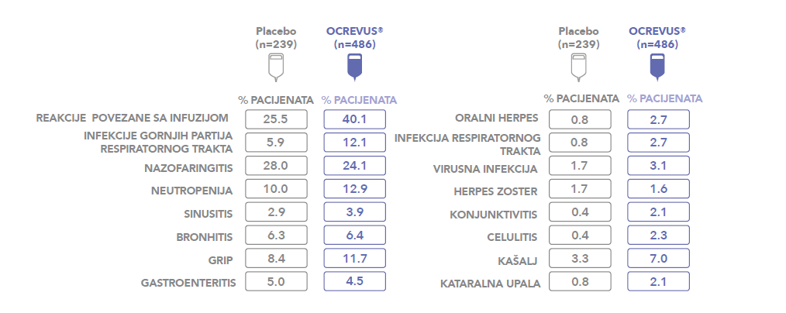
ORATORIO: sigurnosni profil
Wolinsky JS, et al. Presented at ECTRIMS 2017 (Poster 1234).

Slide 21
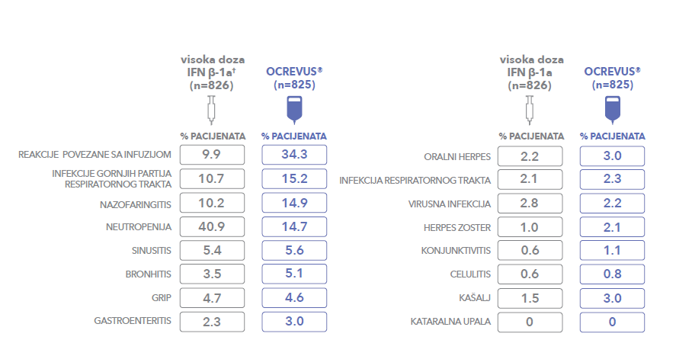
OPERA I i OPERA II: sigurnosni profil
Hauser SL et al. Ocrelizumab versus interferon β-1a in relapsing multiple sclerosis. N Engl J Med. 2017;376(3):221-234.

Slide 22
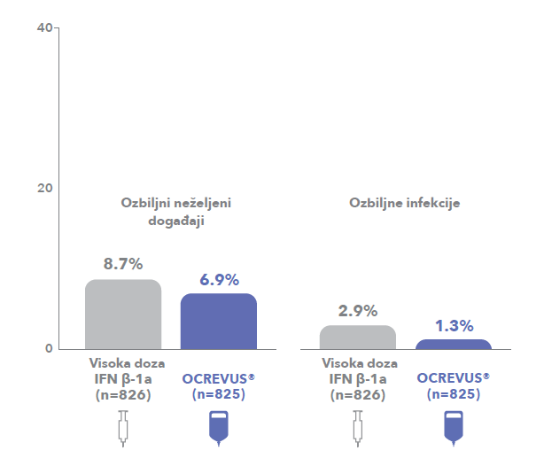
OPERA I i II: ozbiljni neželjeni događaji
Hauser SL et al. Ocrelizumab versus interferon β-1a in relapsing multiple sclerosis. N Engl J Med. 2017;376(3):221-234.

Slide 23
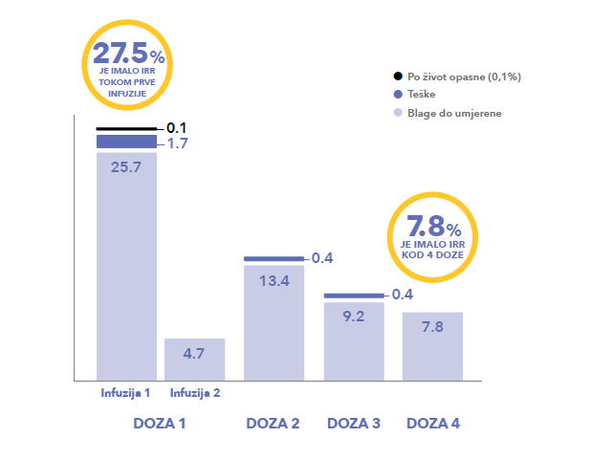
Reakcije povezane sa davanjem infuzije
Hauser SL et al. Ocrelizumab versus interferon β-1a in relapsing multiple sclerosis. N Engl J Med. 2017;376(3):221-234.

Slide 24
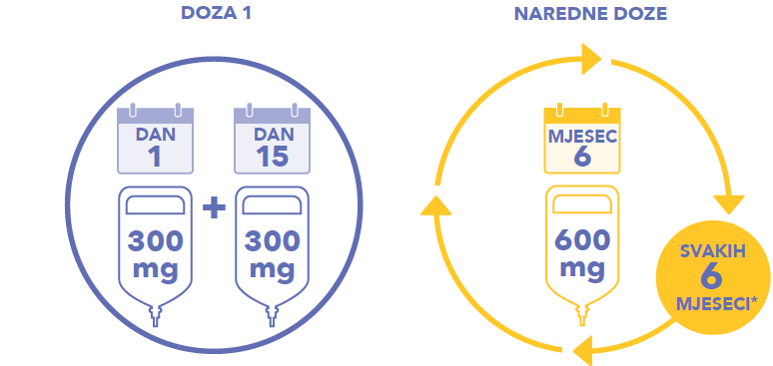
Lijek OCREVUS® (ocrelizumab) - primjena svakih 6 mjeseci bez rutinskog testiranja između dvije doze
Bez rutinskog testiranja na JCV ili kardiovaskilarne simptome
Preporučuje se provjera imunološkog statusa pacijenta prije iniciranja primjene

Slide 25
Doziranja prema SmPC
Godišnje
mjesec 1
mjesec 2
mjesec 3
mjesec 4
Mjesec 5
mjesec 6
mjesec 7
mjesec 8
mjesec 9
mjesec 10
mjesec 11
mjesec 12
SC Interferon β-1a (Rebif)
156
Glatiramer acetate (40mg)
156
Teriflunomide
365
Dimethyl fumarate
730
Natalizumab
12
Fingolimod
365
Alemtuzumab
5
Ocrelizumab
2
Referenca: SmPC navedenih lijekova

Slide 26
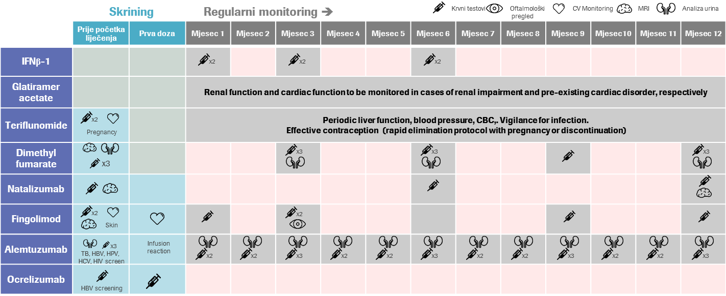
Monitoring prema SmPC
Referenca: SmPC navedenih lijekova

Slide 27
Indikacije i kriteriji za uključivanje lijeka Ocrevus (ocrelizumab) u RMS
Ocrelizumab je indiciran za liječenje odraslih bolesnika s relapsirajućim oblikom multiple skleroze (RMS) s dokazivom aktivnošću bolesti (definiranom kliničkim nalazima ili oslikavanjem) u posljednje 2 godine.
Za gore navedenu definiciju, može se koristiti populacija OPERA ispitivanja:
najmanje dva relapsa u posljednje dvije godine ili relaps u protekloj godini
dokaziva aktivnost bolesti MR oslikavanjem
EDSS* između 0 i 5,5 (uključujući te vrijednosti)

Slide 28
Indikacije i kriteriji za uključivanje lijeka Ocrevus (ocrelizumab) u PPMS
Okrelizumab je indiciran i za liječenje odraslih bolesnika s ranim primarno progresivnim oblikom multiple skleroze (PPMS).
Za definiranje rane faze bolesti može se koristiti populacija ORATORIO ispitivanja:
trajanje bolesti < 10 godina (kod bolesnika s EDSS-om od ≤ 5,0) ili < 15 godina (kod bolesnika s EDSS-om > 5,0)
stepen onesposobljenosti prema EDSS-u između 3,0-6,5
MRI karakteristike tipične za upalnu aktivnost (T1 lezija(e) naglašena(e) gadolinijem i/ili aktivne (nove/rastuće) T2 lezije.

Slide 29
OCREVUS (ocrelizumab) sada dostupan pacijentima u RS
prva i jedina terapija, odobrena za primjenu i kod RMS i kod PPMS
superiorni klinički ishodi uz značajno suzbijanje i aktivnosti i progresije bolesti
povoljan sigurnosni profil u dva identična klinička ispitivanja
jednostavnost primjene svakih 6 mjeseci bez rutinskog testiranja između davanja dvije doze
do danas >4,000 pacijenata je primilo ocrevus u kliničkim studijama i >66,000 pacijenta tretirano u kliničkoj praksi
OCREVUS® (ocrelizumab) SmPC Hauser SL et al. Ocrelizumab versus interferon β-1a in relapsing multiple sclerosis [supplemental appendix]. N Engl J Med. http://www.nejm.org/doi/ suppl/10.1056/NEJMoa1601277/suppl_file/nejmoa1601277_appendix.pdf. Accessed January 3, 2017. Hauser SL et al. Ocrelizumab versus interferon β-1a in relapsing multiple sclerosis. N Engl J Med. 2017;376(3):221-234. Montalban X et al. Ocrelizumab versus placebo in primary progressive multiple sclerosis. N Engl J Med. 2017;376(3):209-220. Rche Data on File.

Slide 30
Iskustva sa primjenom ocrelizumaba u Neurološkoj klinici UKCRS
Doc. dr Daliborka Tadić
Trebinje, 2019.

Slide 31
Pacijenti na terapiji ocrelizumabom
Ukupno na terapiji ocrelizumabom 17 pacijenta u periodu od aprila 2019. do danas
14 pacijenata primilo prvu dozu lijeka u dva akta
2 pacijenta primila prvi dio prve doze
1 pacijent isključen zbog neželjenih dejstava lijeka u toku primjene prvog dijela prve doze

Slide 32
Reakcije preosjetljivosti
1 pacijent isključen iz terapijskog protokola, zbog neželjenog dejstava u vidu generalizovane urtikarije koja se nije povlačila na usporavanje infuzije, niti prestanak davanja lijeka
Nakon preporuke dermatologa dat antihistaminik

Slide 33
Infuzijske reakcije
Osip - 3 pacijenta u toku primanja prvog dijela prve doze i 1 u toku primanja drugog dijela prve doze
Osjećaj iritacije u grlu - 1 pacijent u toku primanja prvog dijela prve doze
Otežano gutanje, pritisak u grudima, zujanje u ušima - 1 pacijent u toku primanja prvog dijela prve doze

Slide 34
Klinički efekti
Kratak period za procjenu

Slide 35
Prikaz slučaja:
Rana RMS

Slide 36
Profil pacijenta
N.R., muškarac
1995. god.
Nezaposlen
Pušač
Bez dosadašnjih bolesti

Slide 37
Klinički profil
2017. - dijagnoza RR MS
2019. - relaps
Januar 2017. slabost donjih ekstremiteta - spontan oporavak
Juni 2017. spastična parapareza, ataksija, pulsna KS terapija- EDSS 3.0
NMR endokranijuma: multiple hiperintenzne T2 lezije, 1 T1 Gd+
NMR cervikalne kičme: hiperintenzne T2 lezije
IEF: intratekalna sinteza IgG
April 2019. pogoršanje
Juli 2019. spastična kvadripareza ataksija, sfinkterijalna disfunkcija, pulsna KS terapija, EDSS 5.0
NMR endokranijuma: multiple hiperintenzne T2 lezije, nove
NMR cervikalne kičme: hiperintenzne T2 lezije, nove

Slide 38
Efficacy of ocrelizumab in early RMS OPERA studies early RMS subgroup*: T1 Gd+ and N/E T2 hyperintense lesions
T1 Gd+ lesions
N/E T2 hyperintense lesions
0.20
90.8%
reduction vs IFN β-1a
p<0.001
2.0
74.3%
reduction vs IFN β-1a
p<0.001
0.164
0.15
1.5
1.504
Early relapsing multiple sclerosis was defined as multiple sclerosis (MS) symptom onset ≤2 years from screening and treatment naïve (i.e., no previous disease-modifying therapy)
Mean number of T1 Gd⁺ lesions per patient per MRI scanª
Mean number of N/E T2 lesions per patient per MRI scan^{b}
0.10
1.0
0.05
0.5
0.386
0.015
0
0
IFN β-1a
44 µg
(n=206)
Ocrelizumab
600 mg
(n=221)
IFN β-1a
44 µg
(n=206)
Ocrelizumab
600 mg
(n=221)
*Early RMS subgroup defined as MS symptom onset ≤2 years, assessment over 96 weeks; ªAdjusted by means calculated by negative binomial regression and adjusted for baseline T1 Gd⁺ lesions (present or not), baseline EDSS (<4.0 vs ≥4.0) and geographic al location (USA vs rest of world)
^{b}Adjusted by means calculated by negative binomial regression and adjusted for baseline T2 lesion count, baseline EDSS (<4.0 vs ≥4.0) and geographic al location (USA vs rest of world) Gd⁺, gadolinium-enhancing; IFN, interferon; MRI, magnetic resonance imaging; N/E, new or enlarging; RMS, relapsing multiple sclerosis; USA, United States of America
Traboulsee A, et al. Presented at AAN 2017 (poster 338).
Notes:
Take-away messages:
Through the 96-week treatment period in the early RMS subgroup of OPERA I and OPERA II (pooled), compared with IFN β-1a, ocrelizumab demonstrated:
A 90.8% reduction in the mean number of T1 Gd+ lesions (0.015 vs 0.164, p<0.001)
A 74.3% reduction in the mean number of new or enlarging T2 hyperintense lesions (0.386 vs 1.504, p<0.001)
These findings were consistent with the overall OPERA population

Slide 39
Efficacy of ocrelizumab in early RMS OPERA studies early RMS subgroup*: Change in whole-brain volume
Baseline to Week 96
Week 24 to Week 96
Week
Week
0
24
48
96
24
48
96
0
0
25.2%
reduction vs IFN β-1a
p=0.001
25.8%
reduction vs IFN β-1a
p=0.004
-0.4
-0.2
-0.4
-0.8
Percentage change (95% CI) in whole-brain volume
Percentage change (95% CI) in whole-brain volume
–1.067
-0.6
-1.2
–0.691
–1.427
-0.8
-1.6
-1.0
–0.931
IFN β-1a 44 µg (n=206)
IFN β-1a 44 µg (n=206)
-2.0
Ocrelizumab 600 mg (n=221)
-1.2
Ocrelizumab 600 mg (n=221)
n
IFN β-1a
OCR
n
IFN β-1a
OCR
175
189
171
182
151
173
139
155
151
173
148
168
136
150
*Early RMS subgroup defined as MS symptom onset ≤2 years. Estimates are from analysis based on mixed-effect model of repeated measures (MMRM). CI, confidence interval; IFN, interferon; OCR, ocrelizumab; RMS, relapsing multiple sclerosis
Traboulsee A, et al. Presented at AAN 2017 (poster 338).
Notes:
Take-away messages:
Through the 96-week treatment period in the early RMS subgroup of OPERA I and OPERA II (pooled), compared with IFN β-1a, ocrelizumab:
Reduced the rate of whole-brain volume loss from baseline to Week 96 by 25.2% (p=0.001)
Reduced the rate of whole-brain volume loss from Week 24 to Week 96 by 25.8% (p=0.004)
These findings were consistent with the overall OPERA population

Slide 40
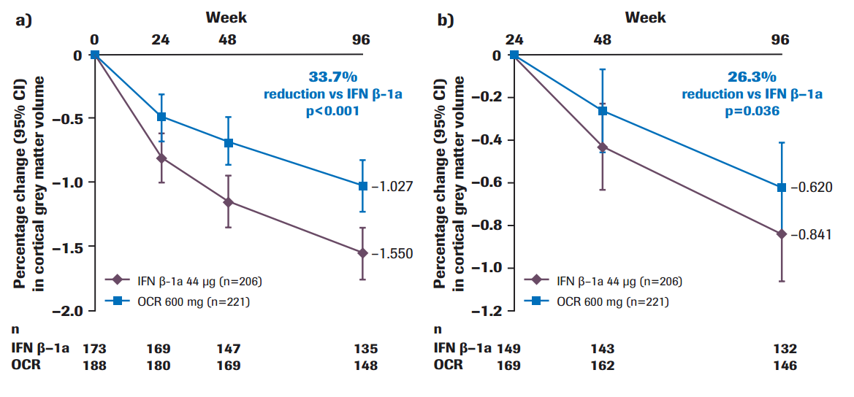
Efficacy of ocrelizumab in early RMS OPERA studies early RMS subgroup*: Change in cortical grey matter volume
Baseline to Week 96
Week 24 to Week 96
Week
Week
0
24
48
96
24
48
96
0
0
33.7%
reduction vs IFN β-1a
p<0.001
26.3%
reduction vs IFN β-1a
p=0.036
-0.4
-0.2
-0.4
-0.8
Percentage change (95% CI) in cortical grey matter volume
Percentage change (95% CI) in cortical grey matter volume
–1.027
-0.6
–0.620
-1.2
–1.550
-0.8
–0.841
-1.6
-1.0
IFN β-1a 44 µg (n=206)
IFN β-1a 44 µg (n=206)
-2.0
Ocrelizumab 600 mg (n=221)
-1.2
Ocrelizumab 600 mg (n=221)
n
IFN β-1a
OCR
n
IFN β-1a
OCR
173
188
169
180
147
169
135
148
149
169
143
162
132
146
*Early RMS subgroup defined as MS symptom onset ≤2 years. Estimates are from analysis based on mixed-effect model of repeated measures (MMRM). CI, confidence interval; IFN, interferon; MS, multiple sclerosis; OCR, ocrelizumab; RMS, relapsing multiple sclerosis
Traboulsee A, et al. Presented at AAN 2017 (poster 338).
Notes:
Take-away messages:
Through the 96-week treatment period in the early RMS subgroup of OPERA I and OPERA II (pooled), compared with IFN β-1a, ocrelizumab:
Reduced the rate of cortical grey matter volume loss from baseline to Week 96 by 33.7% (p<0.001)
Reduced the rate of cortical grey matter volume loss from Week 24 to Week 96 by 26.3% (p=0.036)

Slide 41
Post hoc subgroup analysis: Patients with NEDA during the 96-week double-blind treatment period Early RMS subgroup¹
60
76% improvement vs IFN β-1a
p<0.001
47.6
50
40
Proportion of patients with NEDA from baseline to Week 96 (%)
28.0
30
20
10
0
IFN β-1a 44 µg (n=193)
Ocrelizumab
600 mg (n=206)
For the overall OPERA population, NEDA at Week 96 was as follows:
Ocrelizumab 47.7% versus IFN β-1a 27.1%; 75% improvement; p<0.001)²
Comparison using the Cochran–Mantel–Haenszel test stratified by study, geographic region (USA vs rest of the world) IFN, interferon; MS, multiple sclerosis; NEDA, no evidence of disease activity; RMS, relapsing multiple sclerosis
1. Havrdová E, at al. Presented at AAN 2017 (poster 391);
2. Hauser SL, et al. N Engl J Med 2017;376:221–34 (Suppl appendix).
Notes:
Take-away messages:
A post-hoc analysis was carried out to determine the proportion of patients maintaining NEDA during the controlled treatment phase (Week 0 [study baseline] to Week 96) in a subgroup of patients from OPERA I and II with ‘early RMS’¹
NEDA was defined as the absence of protocol-defined relapses, 12-week confirmed disability progression (CDP), T1 gadolinium-enhancing (Gd+) lesions and new/enlarging T2 lesions
Early RMS was defined as MS symptom onset ≤2 years from screening and treatment naïve (i.e. no previous disease-modifying treatment)
Components of NEDA were analysed both individually and as composite components¹
No evidence of clinical disease activity (comprised of no relapses and no 12-week CDP), and
No evidence of magnetic resonance imaging (MRI) measures of disease activity (comprised of no new/enlarging T2 lesions and no T1 Gd+ lesions)
Reference:
1. Havrdová E, et al. Presented at AAN 2017 (poster 391).
Glossary:
Confirmed disability progression (CDP): defined as an increase in EDSS of at least 1.0 point (or 0.5 points if baseline EDSS was greater than 5.5) sustained for at least 12 weeks
Early RMS subgroup: Patients with MS symptom onset ≤2 years
No evidence of disease activity (NEDA): a composite measure of MS disease activity, including relapses, disability progression, and MRI activity

Slide 42
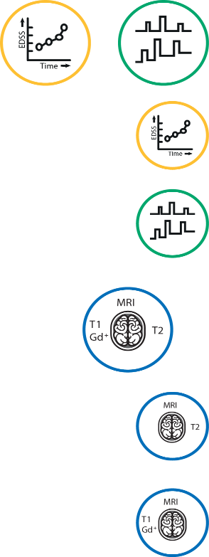
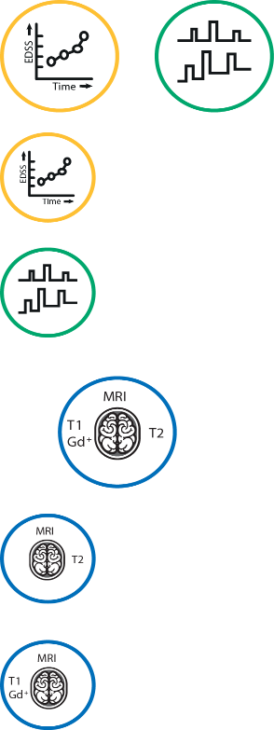
Post hoc subgroup analysis: Percentage of patients with NEDA and NEDA components Early RMS subgroup¹
IFN β-1a 44 µg
(n=193)
OCR 600 mg (n=206)
65%
No evidence of disability worsening or relapse
75%
86%
No 12-week CDP
89%
69%
No protocol-defined relapse
82%
37%
No evidence of MRI measures of disease activity
60%
38%
No new or enlarging T2 lesions
60%
73%
No T1 Gd+ lesions
96%
Results seen for the early RMS subgroup were consistent with the overall OPERA population²
1. Havrdová E, at al. Presented at AAN 2017 (poster 391);
2. Hauser SL, et al. N Engl J Med 2017;376:221–34 (Suppl appendix).
NEDA reference populations, early MS subgroup: IFN β-1a n=193, ocrelizumab n=206 CDP, confirmed disability progression; Gd+, gadolinium-enhancing; IFN, interferon; MRI, magnetic resonance imaging; NEDA, no evidence of disease activity; OCR, ocrelizumab; RMS, relapsing multiple sclerosis
Notes:
Take-away messages:
In the early RMS subgroup, greater proportions of patients were without disease activity for each individual component of NEDA during the controlled treatment phase with ocrelizumab compared with IFN β-1a¹
This was reflected in the proportion of patients with:¹
No disability worsening and clinical disease activity (no 12-week CDP and no relapses: ocrelizumab 74.8% versus IFN β-1a 65.3%), and
No MRI measures of disease activity (no new or enlarging T2 lesions and no T1 Gd+ lesions: ocrelizumab 59.7% versus IFN β-1a 37.3%)
Reference:
1. Havrdová E, et al. Presented at AAN 2017 (poster 391).
Glossary:
Confirmed disability progression (CDP): defined as an increase in Expanded Disability Status Scale (EDSS) of at least 1.0 point (or 0.5 points if baseline EDSS was greater than 5.5) sustained for at least 12 weeks
Early RMS subgroup: Patients with MS symptom onset ≤2 years
No evidence of disease activity (NEDA): a composite measure of MS disease activity, including relapses, disability progression, and MRI activity

Slide 43
There is consensus on high-efficacy therapy for patients with poor prognosis
2017 ECTRIMS/EAN consensus on
managing patients with MS
Offer early treatment with DMTs to patients with active RMS as defined by clinical relapses and/or MRI activity; also includes CIS fulfilling current diagnostic criteria for MS
In active RMS, choice of DMT, in discussion with the patient, will depend on:
Patient characteristics and comorbidities
Disease severity/activity
Drug safety profile
Accessibility of the drug
High-efficacy therapy given if prognostic factors predict poor outcomes
CIS, clinically isolated syndrome; DMT, disease modifying therapy; EAN, European Academy of Neurology; ECTRIMS, European Committee of Treatment and Research in MS; RMS, relapsing MS.
Montalban X, et al. Mult Scler 2018;24:96–120.
Notes:
There is leverage to select highly effective therapies for some patients with negative prognostic factors.

Slide 44
In real-world cohorts early, high-efficacy therapy slows disability progression
Early, high-efficacy therapy vs escalation therapy
100
Adjusted HR (95% CI): 0.74 (0.52-1.06), p=0.10
60% of escalation approach patients experienced disability accumulation prior to escalation
“Contemporary surveillance strategies and escalation protocols may be insufficiently responsive”
80
60
Not Yet Reaching SAD, %
40
Early intensive treatment
20
Escalation approach
0
0
4
8
12
16
20
Time Since Starting DMT, years
No. at risk:
ESC
316
75
21
6
1
EIT
89
29
12
1
0
DMT, disease modifying therapy; EIT, early intensive treatment; ESC, escalation approach; SAD, sustained accumulation of disability.
Harding K, et al. JAMA Neurology 2019; DOI:10.1001/jamaneurol.2018.4905.
Notes:
Median (95%CI) time to SAD was 6.0 (3.17-9.16) years for EIT and 3.14 (2.77-4.00) years for ESC (P=0.05)
Three recent observational studies, seems 5 year observation is needed to discern differences in disability

Slide 45
Hvala za pažnju!

Slide 46
Prikaz slučaja - PPMS
Dr Branislava Ćurčić
UB Foča

Slide 47
Anamnestički podaci
Č.D.
rođ. 1962 (57 godina)
Desnoruk
Oženjen, otac dva zdrava sina
Negira alergije
Majka imala dijabet, brat umro od leukemije
Pušač, konzumirao alkohol
Zanimanje - mašinski tehničar

Slide 48
Anamneza
Prva hospitalizacija na neurologiji od 23.10.2017. do 31.10.2017.
Glavne tegobe: nestabilnost pri hodu, trnjenje stopala i pojačan apetit.
Na dan prijema, ujutru nakon buđenja, pacijent je osjetio izraženo trnjenje u oba stopala, a nakon toga i nestabilnost u hodu, težinu u nogama, od koljena naniže “klecanje nogu”.
Primjetio da ima pojačan apetit i da češće mokri.
Slične tegobe, ali slabijeg intenziteta, imao u septembru 2017. Tegobe su se tada same povukle, te im nije pridavao značaj.

Slide 49
Prikaz slučaja
Ranije bolesti negira, nije uzimao nikakvu hroničnu terapiju.
Neurološki nalaz na prijemu ( 2017): svjestan, orjentisan, komunikativan, na CN: laka semiptoza lijevog kapka, ostali nalaz neupadljiv. Na GE i DE: diskretna slabost lijevih ekstremiteta. GMS-4+, pri probi tonjenja tonu lijeva ruka i lijeva noga, plantarni odgovor atipičan lijevo.
Negira ispade senzibiliteta, hod nesiguran, moguć uz pridržavanje.
Laboratorijski nalazi (2017): Šuk 19,9; Se 50/100, Le 10,8; urin: masa bakterija;
Urađen ultrazvuk abdomena, konsultovan pneumoftiziolog, oftalmolog i endokrinolog.

Slide 50
CT endokranijuma(24.10.2017)
Ekstracerebralni prostori lako širi, na račun kortikalnih reduktivnih promjena. Komorni sistem medioponiran. Supratentorijalno desno, subkortikalno u zoni bazalnih ganglija, na granici talamusa i kapsule interne, diferencira se ovalna zona dijametra 15x13x18 cm, hipodenzna, homogena, jasno ograničena, bez CT znakova perifokalnog edema ili kompresije susjednog parenhima. Infratentorijalno u moždanom parenhimu bez značajnih CT promjena. Koštane strukture bez CT znakova patološkog procesa.
Zaključak: Incipijentne kortikalne reduktivne promjene. Ishemijska zona desno u zoni bazalnih ganglija, subakutnih CT karakteristika.

Slide 51
CDS KS vrata ( 27.10.2017)
AACC jednakih lumena, urednih protoka, IMK 0,7 mm. U oblasti, bulbusa, bifurkacija i početnih segmenata ACI i ACE obostrano, izraženije lijevo u bulbusima niskoprocentne aterosklerotske promjene u vidu fibrokalcifikovanih plakova sa najvećom redukcijom lumena do 30%, hemodinamski parametri zadovoljavajući. ACI elongirane. AAVV normalnog dijametra, anterogradnog smjera protoka, suficijentne. Kontrolni dopler MAV za 6-12 mjeseci.

Slide 52
Prikaz slučaja:
Pacijent otpušten pod sledećim dijagnozama:
Infarctus cerebri cum hemiparesis l.sin;
Diabetes mellitus de novo;
Hypertensio arterialis;
Sy. depresivum;

Slide 53
Prikaz slučaja
Druga hospitalizacija na neurologiji od 15.07.2019. do 30.07.2019.
Glavne tegobe: nemogućnost samostalnog hoda i stajanja, ukočenost u lijevoj nozi , bol u lijevom kuku i koljenu.
Tegobe počele prije mjesec dana u vidu bola u lijevom kuku i koljenu, sa osjećajem ukočenosti lijeve noge što mu je otežavalo kretanje.
Stanje se progresivno pogoršavalo, tako da par dana pred prijem nije mogao samostalno da se kreće.

Slide 54
Prikaz slučaja:
Neurološki nalaz: svjestan, orjentisan, komunikativan, na CN-u: osjećaj mirisa očuvan, vid koriguje naočarima. Širina vidnog polja ispitana grubom metodom konfrontacije uredna. Bulbusi medioponirani, pokretni u svim pravcima, duple slike negira, sitan horizantalan nistagmus pri pogledu u lijevu stranu.
Zjenice simetrične, očuvana reakcija zjenice na svjetlost, blaga insuficijencija konvergencije, negira ispade senzibiliteta. Snaga maseterične muskulature uredna. Mimična muskulatura simetrično inervisana. Nepčani luci simetrični u miru i fonaciji. Govor nazalan, gutanje uredno. Jezik uredne snage i trofike. Vrat slobodan, Lhermit negativan. GE: hipotrofija, više distalno (naglašeni interosealni prostori na šakama), tonus lako povišen lijevo po piramidnom tipu, MR pojačani (vodi lijeva strana), diskretno slabiji stisak lijeve šake (GMS ocjena 4+), u Wartembergu semipronacija lijeve šake, lako koriguje lijevu ruku. Na DE hipotrofija, više distalno. Tonus povišen po piramidnom tipu, MR pojačani, pozitivni suprapatelarni refleks (vodi lijeva strana), klonus patele, klonus stopala obostrano. Pozitivan Babinski obostrano. Eleviranu lijevu nogu ne odiže od postelje, eleviranu desnu nogu odiže do 20 stepeni. Hipestezija od nivoa Th6/Th8, parestezije stopala. Samostalno stajanje i sjedenje nisu mogući. Urgencija mokrenja.

Slide 55
Prikaz slučaja
CT endokranijuma (18.07.2019.)
Pregled rađen po standardnom protokolu bez iv aplikacije kontrasta. U frontoparijetalnom subkorteksu uočava se manja zona nižeg denziteta nejasno delineirana od okolnih struktura, a koja je nespecifičnih karakteristika u smislu vaskularne, demijelinizacione ili neke druge geneze. Dodatno u talamokapsularnoj regiji sa desne strane diferentna linearna zona nižeg denziteta, veličine 15 mm, a koja sugeriše sekveli CVI. U ostalim regijama nalaz bez jasne patološke alteracije. Ventrikularni sistem pravilno pozicioniran, likvorskog sadržaja. Cisterne na bazi i sulkusi primjerene širine. Na koštanim strukturama kranijuma ne uočavaju se značajne patološke promjene. Nalaz zahtjeva dodatnu neuroimaging obradu-MR.

Slide 56
Prikaz slučaja

Slide 58
DIJAGNOZA: ?

Slide 59
HVALA NA PAŽNJI

Slide 60
Dobra saradnja između regionalnih centara u RS i UKCRS
Dr Vesna Arsić-Pejić (JZU „Bolnica Srbija“, Istočno Sarajevo)
Dr Sonja Radović (JZU „Bolnica Trebinje“, Trebinje)
Dr Svetlana Jevtić (JZU „Sveti Vračevi“, Bijeljina)

